Slide 1
SmartPlant 3D Drawings Creation
Global Services

Slide 2
Classes of Output
Orthographic Drawings
Composed – Composed and Snapshot
By Query – Volume and DBQ
3D Outputs
3D Model Data (vue and XML files)
SAT file
MicroStation 3D DGN
Piping Isometric Drawings
Spreadsheet Reports

Slide 3

Composed Drawings
1
2
3
2
1
Multiple Views
3
Multiple Volumes

Slide 4
Snapshot Drawings
1
2
3
2
1
Multiple Views
3
Multiple Volumes

Slide 5
Volume Drawings
1
2
3
1
Multiple Views
2
3
Single Volume

Slide 6
Drawings by Database Query
1
2
3
1
Multiple Views
2
3
Single Volume as
Defined by the Filter

Slide 7
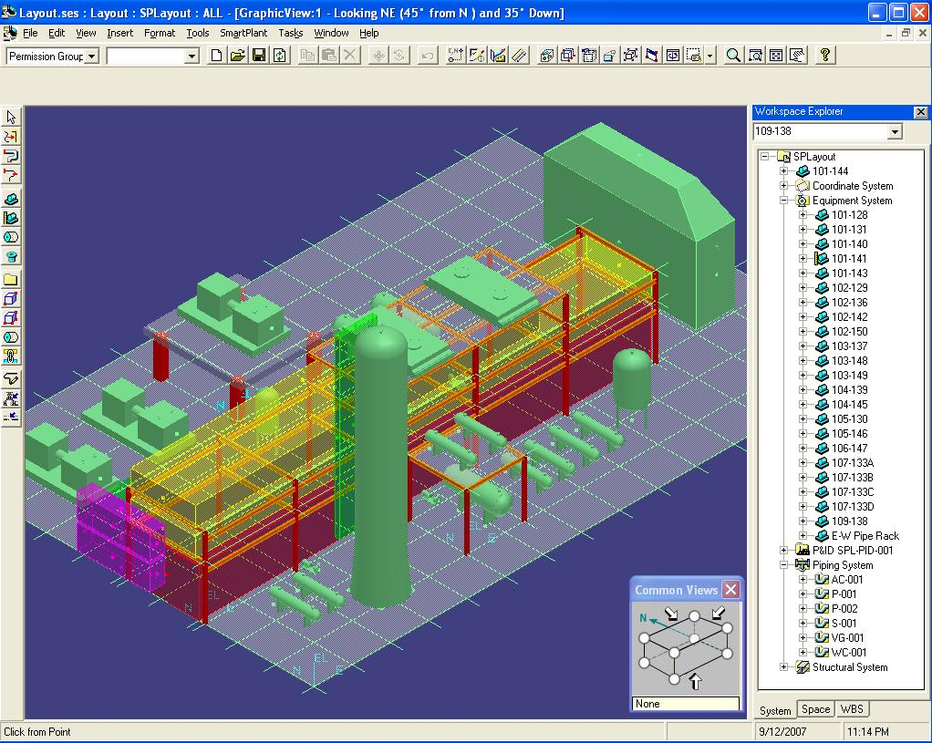
User Interface
Standard Menus
Standard Icons
Select
Filter
Pin Point controls
Select
Icon
Task
Specific
Icons
Workspace Explorer
Status Bar
Workspace Tabs

Slide 8
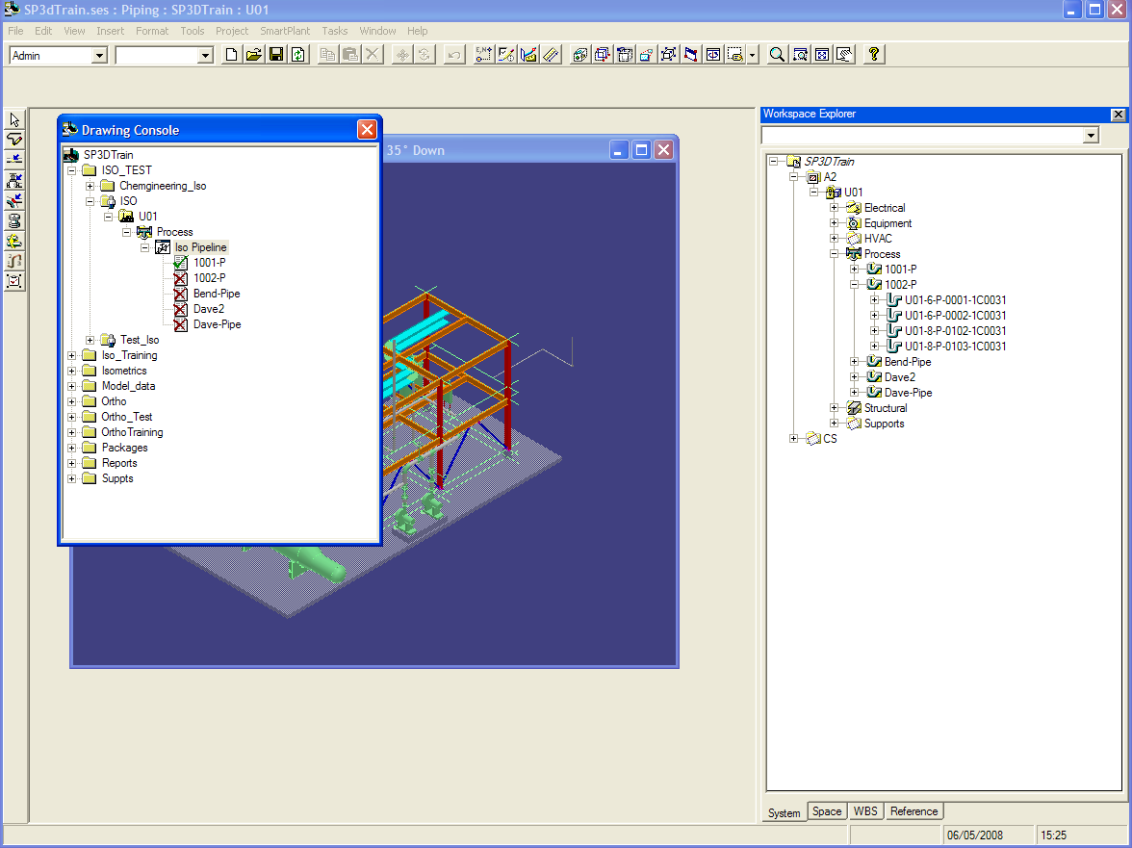
User Interface
Drawing
Console

Slide 9
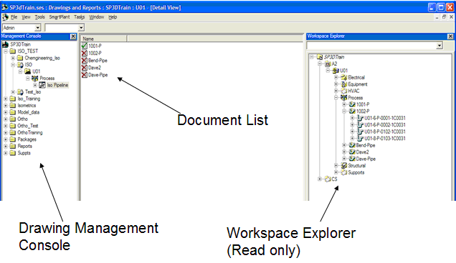
User Interface

Slide 10
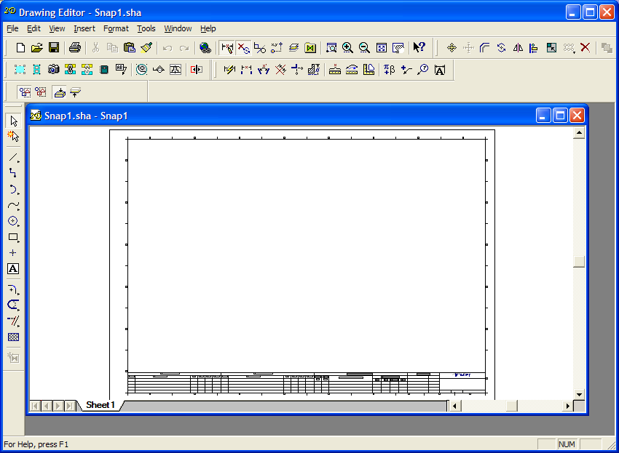
User Interface
Drawing
Icons

Slide 11
Composed Drawing Workflow – Drawing Console
Create New Drawing
Name the drawing
Choose Layout Template
Choose Border Template
Set Drawing Properties
Update Drawing

Slide 12
Composed Drawing Workflow – Drawing Editor
Place Graphic View and choose view style, scale and orientation
Place Report View
Update View

Slide 13
Composed Drawing Workflow – 3D
Place Volumes (Space Management)
Associate Views to other Views, Volumes and Filters (Any 3D Task)

Slide 14
Drawing View Reports

Slide 15
Snapshot View Workflow
Snapshot View in 3D
Impact of Clipped 3D View
Impact of Workspace Filter
Impact of Hidden Objects
Preview Option
Place view on 2D Sheet
Update View

Slide 16
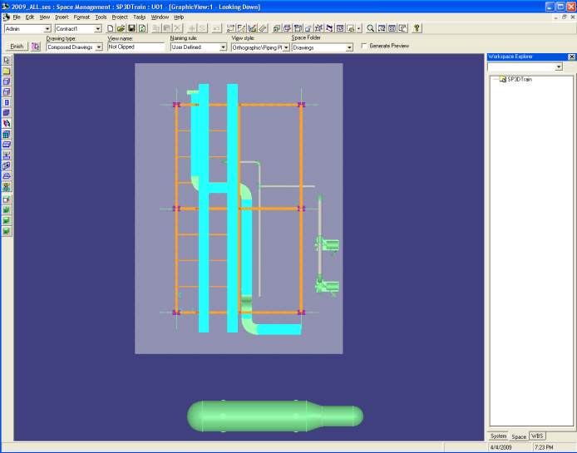
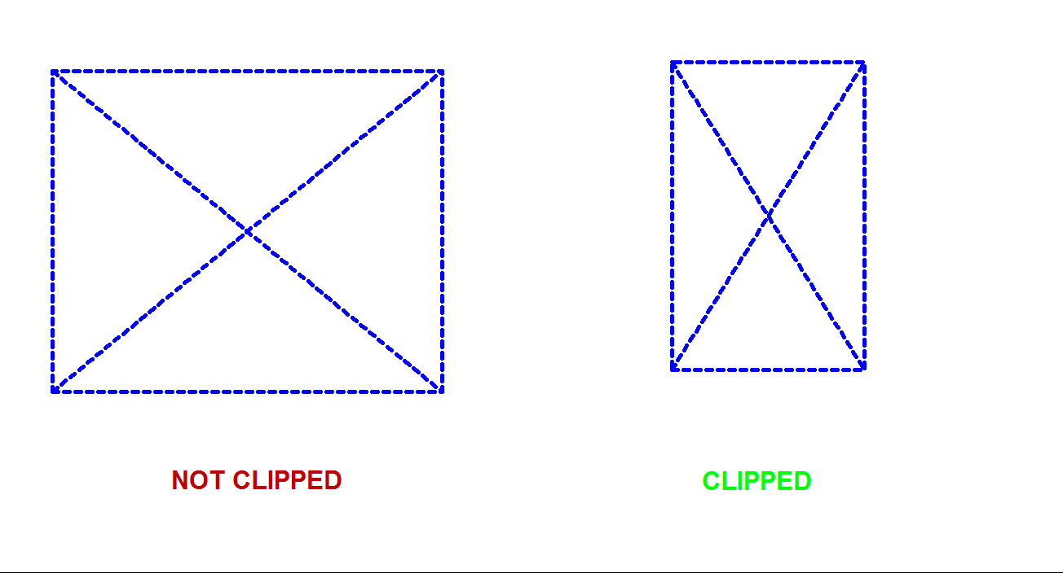
Snapshot - Impact of Clipped View
If the 3D view is clipped – the view matches dimensions of the clipping volume
If the 3D view is not clipped - the volume matches dimensions of the 3D window

Slide 17
Snapshot – Impact of Workspace Filter
The definition of the workspace filter is stored with the snapshot view, not the result of the filter
e.g. if the workspace filter definition is all nested objects under U01 system, this is what is remembered, not the list of objects returned by the filter when the snapshot is made
as a result if additional objects are modeled that belong to U01 system and the drawing is updated, they will appear on the updated drawing

Slide 18
Snapshot – Impact of Hidden Objects

Slide 19
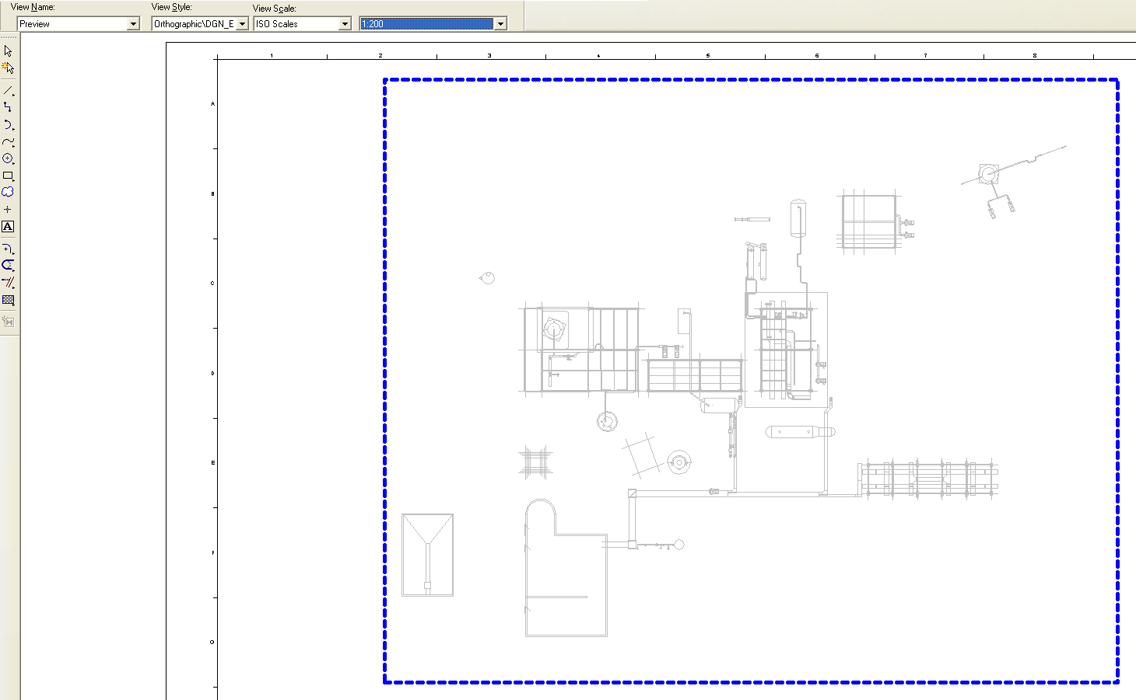
Snapshot – Preview Option
Preview option shows preview of graphics (using 3D VHL) before placement
This can be used for large drawings that do not update in 2D VHL due to size

Slide 20
Volume Placement Methods
Two Points, Four Points, By Selection, By Grids and Planes
Volume Along Single Segment Path
Use of Global vs Object coordinate system for view orientation

Slide 21
Section and Detail View Workflows
Place cutting plane, place section view and update
Place detail envelope, place detail view and update
Volumes automatically created in 3D

Slide 22
Volume Drawing Workflow
Add New Component
Create New Volume and choose type
Create Drawing
Set Drawing Properties
Update Drawing

Slide 23
Drawings by Volume Placement

Slide 24
Drawing with a Keyplan

Slide 25
Volume and Composed Drawing Comparison
Composed | Volume
One Volume Per View | One Volume Per Drawing
Volume can be associated to multiple views in different drawings Views number and arrangement variable | Volume cannot be shared between drawings Views number and arrangement fixed
Can add section and detail views | Cannot add section and detail views
View content determined by style, filter and volume | View content determined by style and volume
Requires separate association step | Association automatic
Match lines and key plans require volumes to be placed under same parent folder | Match lines and key plans automatic

Slide 26
Drawing By Query Workflow
Add DBQ Manager and setup filter and package
Run Query and Create Drawings
Set Drawing Properties
Update Drawing

Slide 27
Sample DBQ Output

Slide 28
MicroStation 3D DGN Workflow
Add New Component and Setup seed and view style
Create New Volume
Update Drawing

Slide 29
3D Model Data and SAT Workflow
Add 3D Model Data Component and choose type and location
Setup Filter and Create Drawing
Update Drawing

Slide 30
SmartSketch Basics
Layers
Text
Dimensioning
Symbol Explorer
2D PinPoint
Align command on change toolbar

Slide 31
Label Placement
Workflow – select label, select object, click and place
Use of as-drawn
Leader option (inside or boundary)
Dimension Style Labels

Slide 32
Dimension Placement
Dimension Styles
Smart Dimension
Distance Between
Angle Between

Slide 33
2D Editing
Scaled Sketching
User-graphics and text placement
Moving views on a sheet
Which label changes are preserved
Label position on sheet relative to view
Label look and feel

Slide 34
Save as DGN and DWG
Merge Reference option in itacad.ini

Slide 35
Miscellaneous Topics
2D/3D highlight
Batch Updates
Troubleshooting

